Slide 1
New Featured Standard
ISO 31000-2018

Slide 2
Five things you need to know
There are five differences between the 2009 and 2018 versions
New simplified language with purpose statements
  Technical terms and definitions were reduced from 29 to 8
Value creation and protection - eight new principles for risk framework and process include:
  A structured, integrated and comprehensive approach to risk
  Customizing to include stakeholders and consider human and cultural factors
  Being dynamic and responsive to organizational changes
  Using best practices for learning, adapting and continually improving

Slide 3
Five things you need to know (continued)
There are five differences between the 2009 and 2018 versions
Total integration
  Across all employees and all activities
Leadership from management
  Oversight bodies are accountable for overseeing risk management
Risk management is an interactive process
  Manage risk when decisions are being made
  Repetition of a sequence of operations yields results successively
  closer to a desired result

Slide 4
The Risk Management Process
XXXXX
It’s a continuous process
There is a logical flow to the process
An organization can implement risk management at any part of the organization and at any part of the cycles a continuous process
There is a logical flow to the process
An organization can implement risk management at any part of the organization and at any part of the cycle
Graphic developed by Bruce K. Lyon, adapted from IEC/DIS 31010-2018

Slide 5
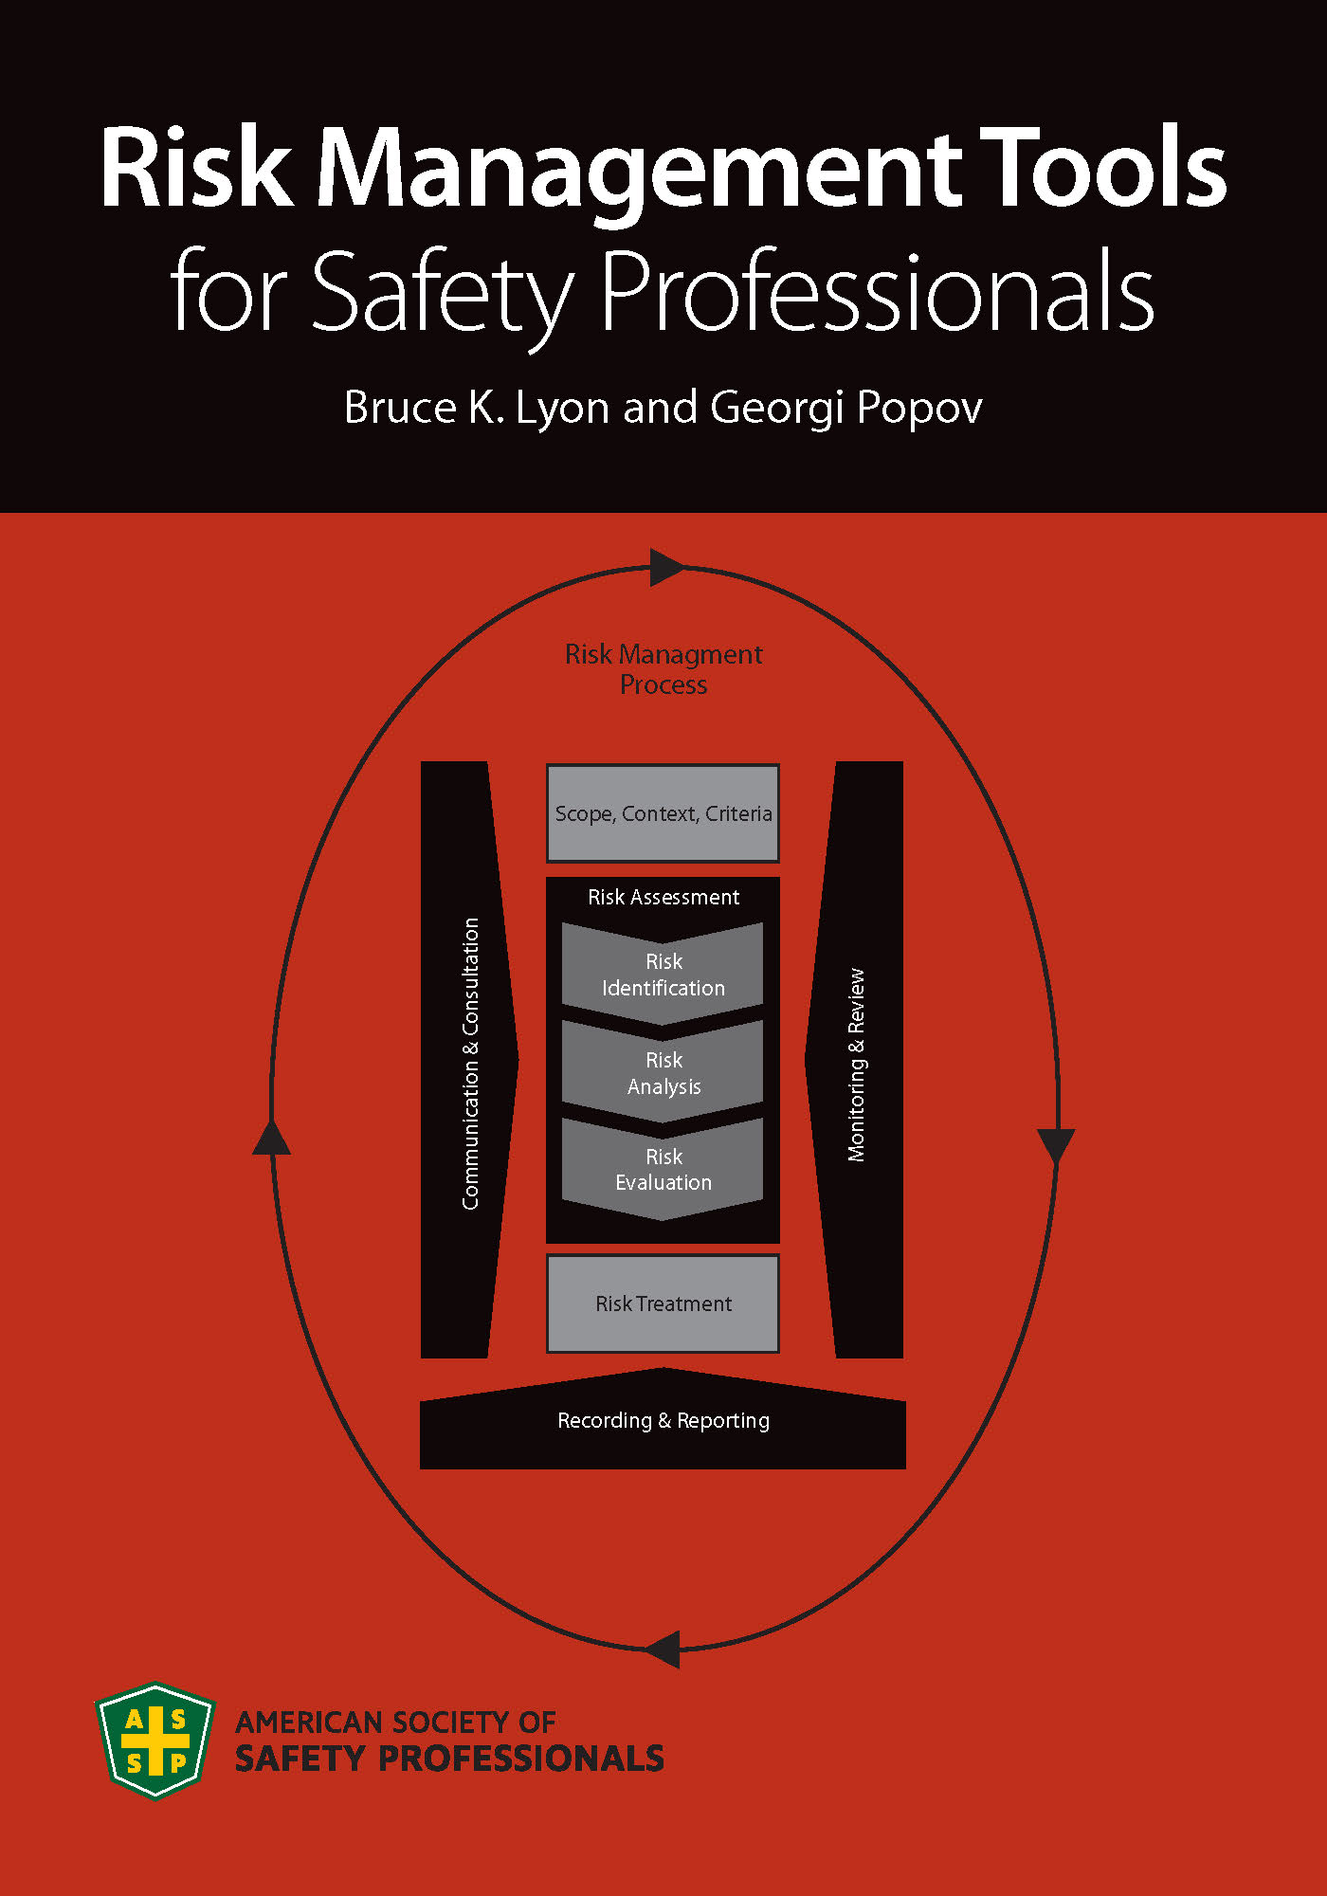
ASSP has published a new book on risk
Risk Management Tools for Safety Professionals
by Bruce K. Lyon and Georgi Popov
The authors expand on the ISO 31000, Z690, Z10 and Z590.3 standards providing a step-by-step guide to the risk management process
The book includes practical examples of risk management applications and prevention through design concepts
The authors make use of case studies on risk treatment and
business interface
Downloadable interactive tools and 28 risk management tools
are included

