Slide 1
We Take Care of Everyone — Who’s Taking Care of Us?
Mental Health for Safety Professionals
Advisory Group
December 2025
Notes:
We’re experts at taking care of everyone else. But today, we’ll talk about something just as important — how we take care of ourselves.

Slide 2
Agenda
Welcome
Mental Health for Safety Professionals
Breakout Discussions
Report Out
Reminders
Notes:
ERIC
Today’s purpose: we’ll discuss why it important to pivot in our work as OSH Professionals, how to approach making that pivot and discuss our experiences with pivoting in our roles.
Agenda overview (briefly run through each item ):
Learning to Pivot: a short overview of the pivot framework and 2–3 concrete examples — listen for a simple repeatable method you can use.
Breakout Discussions : small groups will discuss one scenario and apply the framework. Each group should pick a note-taker and a spokesperson.
Report Out : each group will share their key insights relating to our topics. We’ll capture themes and any action items.
Reminders & Next Steps (5 min): resources, reminders and our next steps.
Expectations for breakouts: focus on applying the steps, be concise, capture concrete takeaways or actions, and decide one person to report out.
Wrap-up cue: after report-outs we’ll summarize common themes and confirm any assigned next steps and deadlines.

Slide 3
Let’s Start with a Laugh
Notes:
TBD
We’re not making light of the topic — but sometimes a good laugh reminds us that we all share the human side of this work.

Slide 4
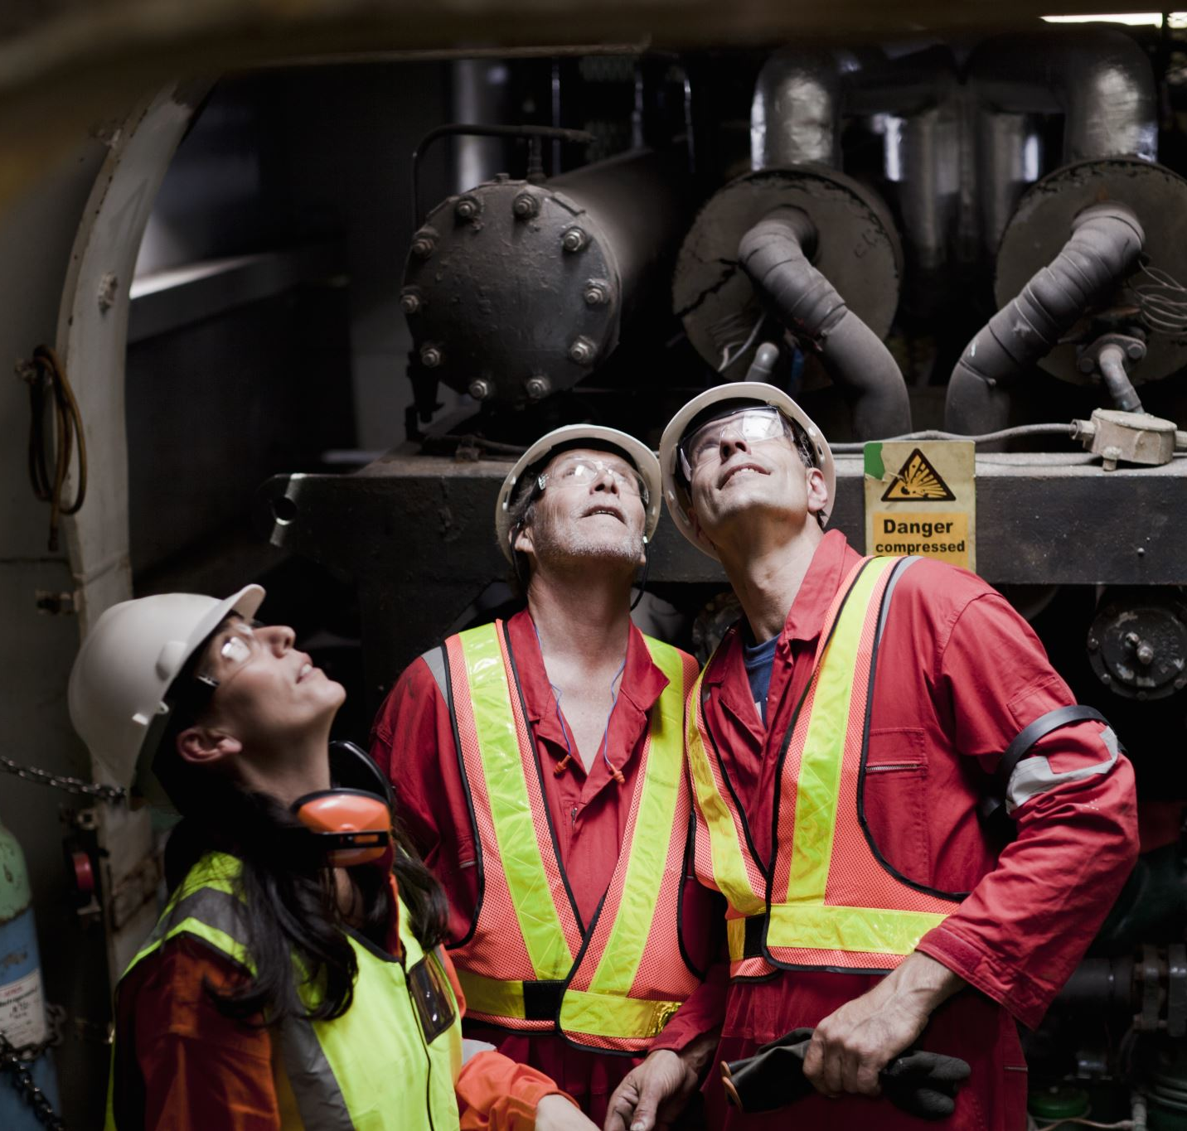
We’re Always on Duty
Constant exposure to risk, trauma, responsibility
Always expected to have the answers
Little room for mistakes or vulnerability
The unspoken rule “Stay strong for others”
Notes:
We carry emotional PPE — invisible gear that protects everyone else but can weigh us down

Slide 5
Stress, Burnout and the Safety Profession
60% report burnout symptoms
40% experience chronic stress
Less than 20% have peer or mental health resources
Notes:
Our profession asks us to lead with empathy — but empathy without recovery leads to depletion.

Slide 6
Safety Starts with Us
Burnout affects decision-making and emotional regulation
Stressed leaders create stressed teams
Healthy professionals = safer workplaces
Notes:
You can’t pour from an empty cup — especially when your job is to fill everyone else’s.

Slide 7

Self-Care Isn’t Selfish
Build recovery into your routine
Try micro-habits: gratitude, short walks, breathing breaks
Set boundaries – saying no can protect your mental health
Notes:
You wouldn’t skip lockout/tagout — don’t skip your own reset procedures.

Slide 8
We’re Stronger Together
Check in with peers: “How are you, really?”
Pair up for informal accountability
Recognize fatigue as a valid safety risk
Notes:
We’re trained to spot hazards — let’s get just as good at spotting when a colleague might be struggling.

Slide 9
From Programs to Culture
Make mental health part of your safety culture
Encourage leaders to model healthy behaviors
Integrate psychological safety into performance metrics
Notes:
When leaders share that they’ve struggled too, it gives everyone else permission to be human

Slide 10
Breakout Discussion
Notes:
We’ve talked about the issue — now let’s explore what support could look like in our world.

Slide 11

Supporting Each Other
Peer Support – 15 minutes
  What unique stressors do safety professionals face?
  What small, realistic steps can strengthen our connection
Organizational Support – 15 minutes
  What could ASSP do to support?
  How do we make mental health part of safety excellence?

Slide 12

Take One Step
Identify one action you’ll take this week for your own well being
Reach out to one colleague and check in
Encourage open conversations on mental health
Notes:
Small actions repeated across a team can shift culture — and protect those who protect others

Slide 13
We are trusted to keep others safe. That trust begins when we care for ourselves — and each other.
Notes:
Reach out if you need help.
Your organization might have an Employee Assistance Program (EAP)
You can also dial or text 988 for confidential mental health support

Slide 14
Reminders
Our next meeting is DATE
  Calendar will be sent DATE
Communication is a two-way street
Advisory Group Webpage
Reach out to Operations Committee or Governance staff at governance@assp.org
Notes:
DALLAS
Note date/time of next meeting and that if they did not receive the calendar invite to reach out to staff at email below and we can resend
Remind them that their role on the AG means that not only do they bring insight and information TO the AG meetings, but also bring topics discussed BACK to their communities.
Remind them that presentations and information is available on the AG Webpage of the ASSP website (Staff will put link in chat)
Remind them that they can reach out to OC or staff at goveranance@assp.org

Slide 15
THANK YOU
Notes:
NICK

