Slide 1

Engineers Week – Engineers in Safety
Lawrence J. H. Schulze, PhD, PE, CPE
Associate Professor
Director, Process Safety Certificate Program
E206 Engineering Building 2
University of Houston, Houston TX 77204-4008
ljhs@uh.edu, docergo@gmail.com, 713-252-2803

Slide 2
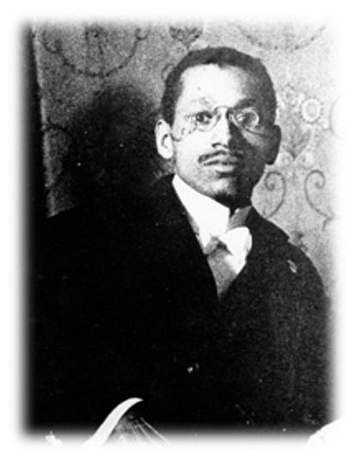
William Hunter Dammond
1873 –1956
Wikipedia & Paul Quinn College

Slide 3
History
1st Black Man to Graduate from the University of Pittsburg (Civil Engineering)
Developed an electric track circuit signaling system
Developed a ‘Safety System for Operating Railroads’

Slide 4
Engineering Practice Specialty – Come Join Us
Safety Engineer Practice Specialty | ASSP

