Slide 1

Engineers Week – Engineers in Safety
Lawrence J. H. Schulze, PhD, PE, CPE
Associate Professor
Director, Process Safety Certificate Program
E206 Engineering Building 2
University of Houston, Houston TX 77204-4008
ljhs@uh.edu, docergo@gmail.com, 713-252-2803

Slide 2
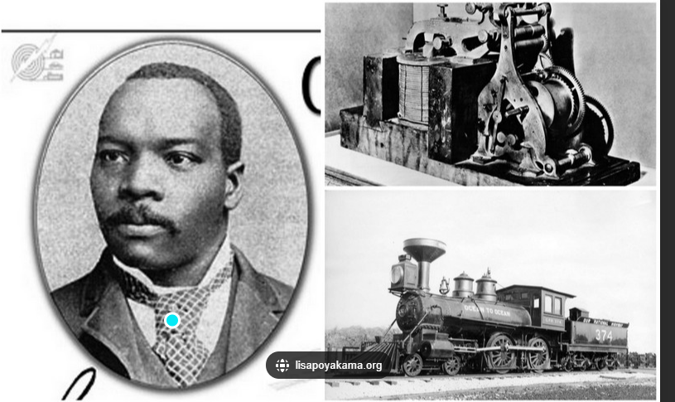
Granville T. Woods
1856-1910
Wikipedia, biography.com

Slide 3
History
Received little school as a young man but studies engineering and electricity
Worked for multiple railroads
Added voice to telegraph wires
Known as the ‘Black Edison’
Inventor of the basis of the ‘third rail’ in electric-powered transit systems

Slide 4
Engineering Practice Specialty – Come Join Us
Safety Engineer Practice Specialty | ASSP

