Slide 1

Engineers Week – Engineers in Safety
Lawrence J. H. Schulze, PhD, PE, CPE
Associate Professor
Director, Process Safety Certificate Program
E206 Engineering Building 2
University of Houston, Houston TX 77204-4008
ljhs@uh.edu, docergo@gmail.com, 713-252-2803

Slide 2
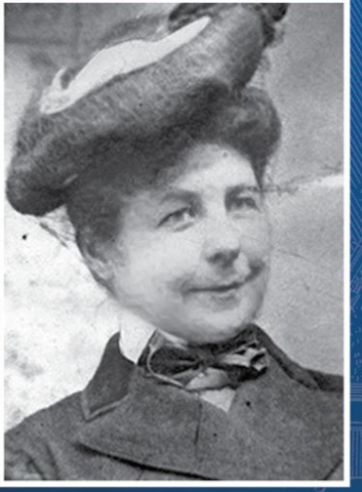
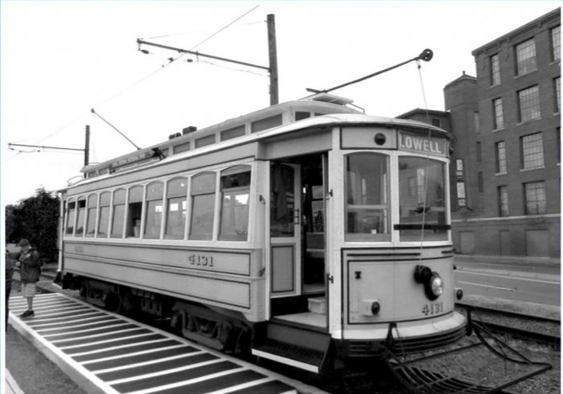
Mary Anderson
1866-1953
Thoughtco.com, Invent.org

Slide 3
History
Unheralded inventor of the windshield wiper
Originally designed for street cars
Filed patent before Henry Ford’s Model T
Patent ran out in 1920
Cadillac 1st car with windshield wipers in 1922

Slide 4
Engineering Practice Specialty – Come Join Us
Safety Engineer Practice Specialty | ASSP

