Slide 1

Engineers Week – Engineers in Safety
Lawrence J. H. Schulze, PhD, PE, CPE
Associate Professor
Director, Process Safety Certificate Program
E206 Engineering Building 2
University of Houston, Houston TX 77204-4008
ljhs@uh.edu, docergo@gmail.com, 713-252-2803

Slide 2
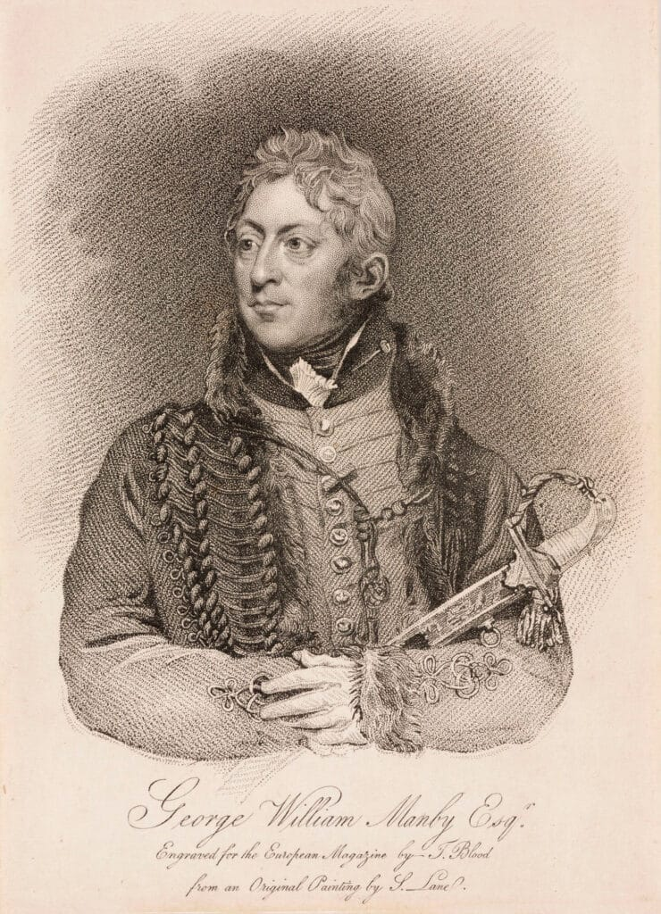
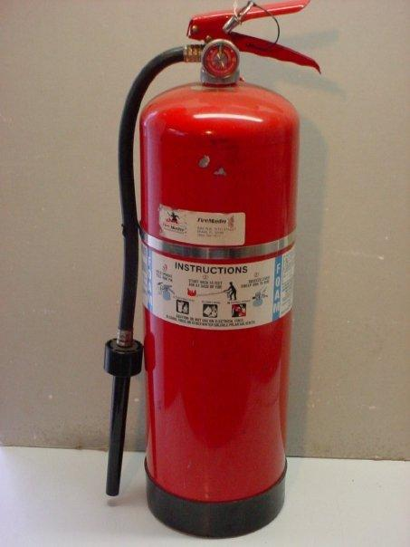
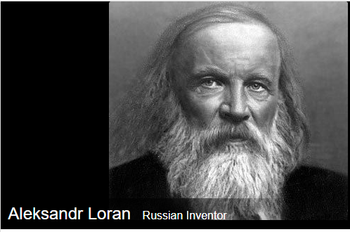
Capt. George William Mamby and
Aleksandr Loran
1765-1854
1849-1911?
Prabook.com, Wikipedia, Fireranger.com, whosdatedwho.com

Slide 3
History
200 BC Ctesibius of Alexander hand pump water spray
1723 1st automatic fire extinguisher
1818 1st protable fire extinguisher, Capt. Mamby
1904 1st chemical foam extinguisher – Aleksandr Loran

Slide 4
Engineering Practice Specialty – Come Join Us
Safety Engineer Practice Specialty | ASSP

